Slide 1
Deep Learning for Beginners
Presentation Subtitle

Slide 2
Introduction to Artificial Intelligence

Slide 3
What is Artificial Intelligence
AI is the science and engineering of making intelligent computers and machines.
AI is the process where we program computers to perform complex tasks.
With AI machines can be able to learn from experiences.
AI allows machines to perform human like tasks.

Slide 4
Advantages of AI
Reduced Human Errors.
Automate Repetitive Tasks.
Quickly Executes Complex Operations.
Availability.
Increase Productivity to Humans.

Slide 5
Applications of AI
Self Driving Cars. e.g Tesla
Recommender Systems. e.g Facebook and Twitter Friends Suggestions.
Facial Recognition System. E.g Face ID/Lock.
Translations e.g Google Translate.
Image Classification/Clusters e.g Google News and Google Photos.
Robotics.

Slide 6
Subsets of Artificial Intelligence
Machine Learning And Deep Learning

Slide 7
Machine Learning
Machine Learning
A field of learning where a machine/computer can be able to perform a task and continue to improve on that tasks based on given training dataset.
A machine learning system is trained to perform a task rather than being programmed.
Training takes place by feeding data to the machine learning system to learn from.

Slide 8
Types of Machine Learning
Supervised Machine Learning
A situation where the training data contains the desired output.
The desired output is sometimes called label or class.
Unsupervised Machine Learning
A situation where the training data does not contain any label or class.
The machine learns by clustering the data in seperate groups.

Slide 9
Limitations of machine Learning
Choice of Machine Learning Algorithm.
Requires large training data.
Tedious process of labelling data.
Data is sometimes bias.

Slide 10
Introduction to Deep Learning
Deep learning is the process where neural network learns from a large amount of data.
A neural network is an architecture where the layers are stacked on top of each other.
Deep Learning was inspired by the human brain.

Slide 11
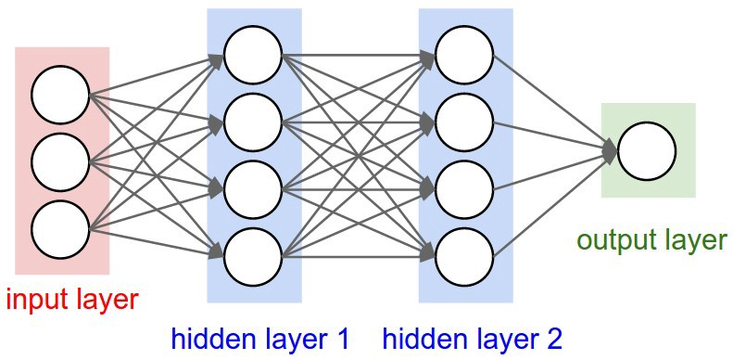
How a Deep Learning Network Works
How Neural Networks are represented.
Input Layer: The input layers receives input features. This input features is the number of features in our dataset.
Hidden Layer: This layer performs mathematical computations on our input data.
A neural networks with more than one hidden layer is referred to as a deep learning neural network.
Output Layer: This contains the output of our neural network.

Slide 12
How a Deep Learning Network Works
How Neural Networks are represented.
Connections between each nodes/neurons is associated with a weight.
Each layer has an activation function.
Activation function defines the output of that node given an input or set of inputs.
Example of activation functions are Rectified Linear Unit (relu), tanh, softmax activation function, sigmoid activation function etc.
Activation function used depends on the problem description, either binary classification, categorical classification, multi-classification etc.

Slide 13
References
https://www.sas.com/en_us/insights/analytics/what-is-artificial-intelligence.html
https://www.getfilecloud.com/blog/2018/06/top-5-limitations-of-machine-learning-in-an-enterprise-setting/
https://www.forbes.com/sites/bernardmarr/2018/10/01/what-is-deep-learning-ai-a-simple-guide-with-8-practical-examples/
https://www.guru99.com/machine-learning-vs-deep-learning.html
https://www.freecodecamp.org/news/want-to-know-how-deep-learning-works-heres-a-quick-guide-for-everyone-1aedeca88076/
https://en.wikipedia.org/wiki/Activation_function
https://www.tensorflow.org/tutorials/keras/classification
https://www.tensorflow.org/tutorials/images/cnn

Slide 14

Thanks!
Contact us:
Your Company
123 Your Street
Your City, ST 12345
no_reply@example.com
www.example.com

